Slide 1
Risk Modelling in Reinsurance
Rithika Adiga
RenaissanceRe

Slide 2
What is Insurance?
Insurance Spreads Risk
Large losses may be disastrous to an individual (family)
Policyholder buys protection from insurance company and, for a premium they can afford, they are protected against an event they can’t afford
Jargon – the insurance company “assumes the risk”
Example (remember this) – You have a 1% chance per year that your house will burn down, it will cost $250,000 to rebuild, insurance premium is $2,500.

Slide 3
Law of Large Numbers
Law of Large Numbers – the more policies an insurance company has, the better it can estimate (and reduce) its risk
Individual – large chance of no loss; 1% chance of a catastrophic loss – this is “risk”
Jargon – Variance decreases as the number of “non-correlated” risks increases
Your house burning down does not affect the likelihood of a house two blocks away burning down – the events are independent

Slide 4
How do insurance companies reduce risk?
Insurance company insures 100 houses
100 X 1% = 1 house per year expected to burn down
Each year, insurance company expects to pay $250,000, the cost of rebuilding one house
Due to law of large numbers, this expected value is much more certain, risk is reduced
Insurance company charges $2,500 per year per policy, thereby covering the cost of rebuilding the house (and spreading the risk)

Slide 5
Reinsurance to the Rescue

Slide 6
Reinsurance is Insurance of Insurance Companies
In the same way insurance companies assume risk from individuals, reinsurance companies assume risk from insurance companies (called ceding companies or cedents)
Insurance companies insure against small non-correlated events such as houses burning down
Reinsurance companies insure against large, non-correlated events, such as hurricanes, earthquakes and tsunamis

Slide 7
Excess of Loss (XOL)
XOL is written in layers, with a limit over a retention
Limit is the potential exposure of the reinsure, retention is the deductible
A reinsurer may be on multiple layers, and multiple reinsurers may be on the same layer
The premium paid for a layer is a percent of the limit, and is called Rate on Line
For a 5 X 5 layer at 10 “on line,” premium is 10% of $5 mm = $500k
5x5 | $5 m
4 x1 | $4 m
500 x 500 | $500k
250 x 250 | $250k
Retention | $250k

Slide 8
Boring Stuff

Slide 9
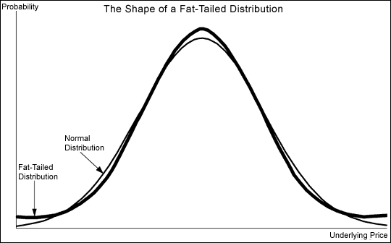
The Tail End
Fat Tail – indicates extreme events are more likely than under a normal distribution – “the tail in that business is fatter than people think”
Out in the Tail – event that is less likely to occur – “I don’t think it will happen, it is really out in the tail”
Long Tail – Business in which losses are expected to be paid out over a long period of time – “I wrote long tail business 10 years ago that is still paying claims”
Short Tail – Business in which losses are expected to be paid out over a short period of time – “Its short tail, so losses should be known within a year”

Slide 10
Libraries most frequently used:
Pandas -> Parquet Handling, dataframe manipulations..
Numpy -> narrays, datatype management..
SciPy -> everything else!

Slide 11


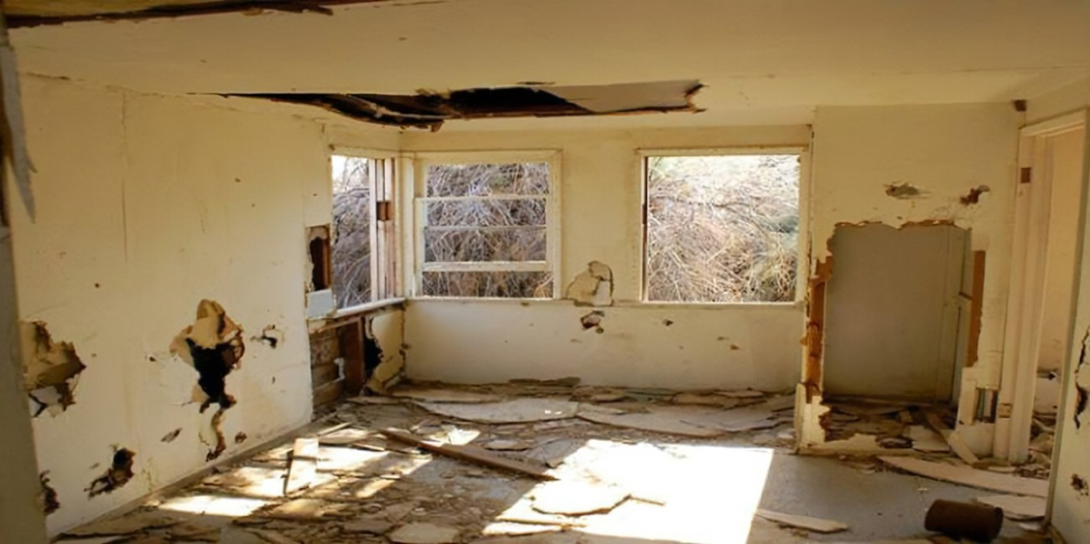
id 45
id 66

Slide 12
100 samples of a beta dist
To sample events from the distribution

Slide 13

Who are we?
Workshop with PyLadies on November 21st!

